Slide 1
Chronos: The Removal of Time
By Luke Foster - 21519352

Slide 2
Project Title
‘The project is going to be a third-person, single-player action role-playing game, based on the Greek God of time Chronos. The game will focus on the exploration and manipulation of time based mechanics to achieve certain goals/quests.’

Slide 3
Introduction
Game Overview
Unity – Game engine software for development (Unity, 2018)
Delta Time – Unity function for local time (Unity, 2017)
Time Manipulation Techniques
Slow Motion – Definition (Evans-Thirlwell, 2017)
Rewind Time – Prince of Persia (Zarzecki, 2016)
Freeze Time – Dishonoured (Sullivan, 2014)
Fast Motion

Slide 4
Background
Inspiration from Smite and Dark Souls
Chronos Smite character (Gamepedia, 2018)
Combat systems (NeuralFrights, 2017)
Mechanics research
Brackey’s YouTube channel (Brackeys, 2017)
Smite ability casting (Jackson, 2014)

Slide 5
Rationale
Why focus around time?
Visual Studio vs Monodevelop (Cogswell, 2010)
Learn AI techniques for combat system from AI module
Prototype demonstrates end game

Slide 6
Aim
‘The aim of this project is to create a prototype game that compares the four core time manipulation mechanics to determine which are more effective integrated into an action combat system, while using an agile methodology backed by supporting UML documentation.’

Slide 7
Objectives - Design
Research to determine project requirements
(Completed by 20/11/17)
Create UML diagrams
(Completed by 01/12/17)
Create sprint plan
(Completed by 10/12/17)
Create back log
(Completed by 16/12/17)
(Overall Completed by December 16th 2017)

Slide 8
Objectives - Development
Develop pseudo code
(Completed by 18/12/17)
Develop movement system
(Completed by 22/12/17)
Develop time mechanic scripts
(Completed by 26/12/17)
Develop combat system
(Completed by 05/01/18)
Develop relevant Artificial Intelligence techniques
(Completed by 19/01/18)
Develop a method so time manipulation can affect Artificial Intelligent behaviour
(Completed by 26/01/18)
(Overall Completed by January 26th 2018)

Slide 9
Objectives - Testing
Determine an expected outcome for the results of the test
(Completed by 20/04/18)
Test Requirements
(Completed by 27/04/18)
Record the actual outcome of the results of the test
(Completed by 27/04/18)
(Overall Completed by April 20th 2018)

Slide 10
Objectives - Implementation
Analyse Development Process
(Completed by 06/05/18)
Build Game for Xbox platform
(Completed by 15/05/18)
Protect Artefact Concept
(Completed by 10/06/18)
Pitch Idea to Games Companies
(Completed by 20/06/18)
(Overall Completed by June 20th 2018)

Slide 11
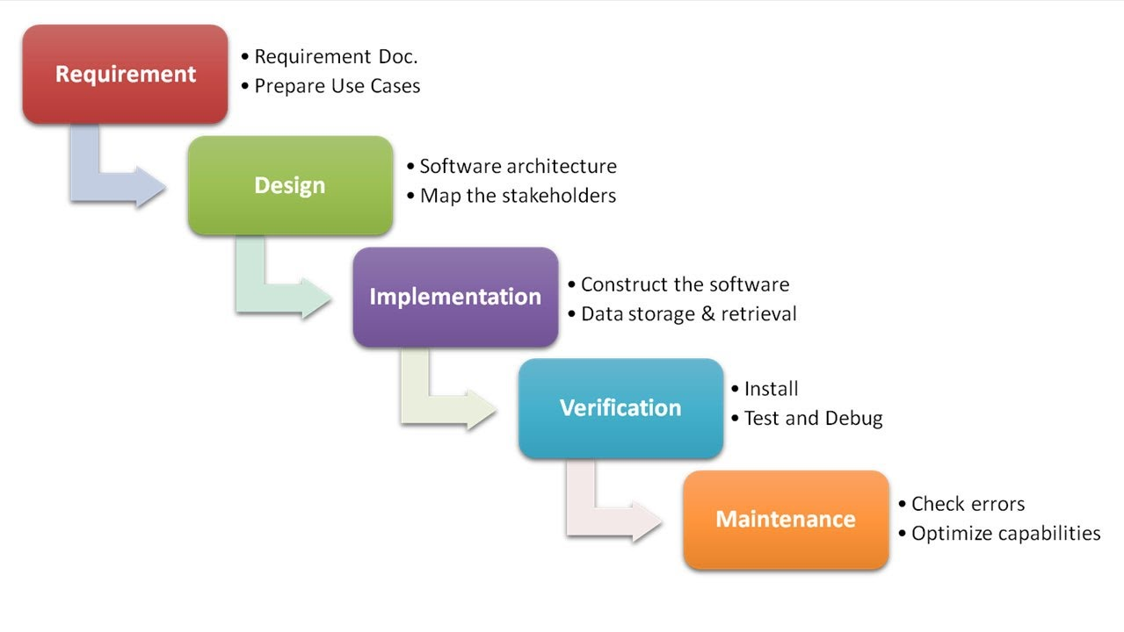
Methodology –Waterfall Analysis
Figure 1 : PowerPoint Waterfall Model (Presentation Process, 2013)

Slide 12
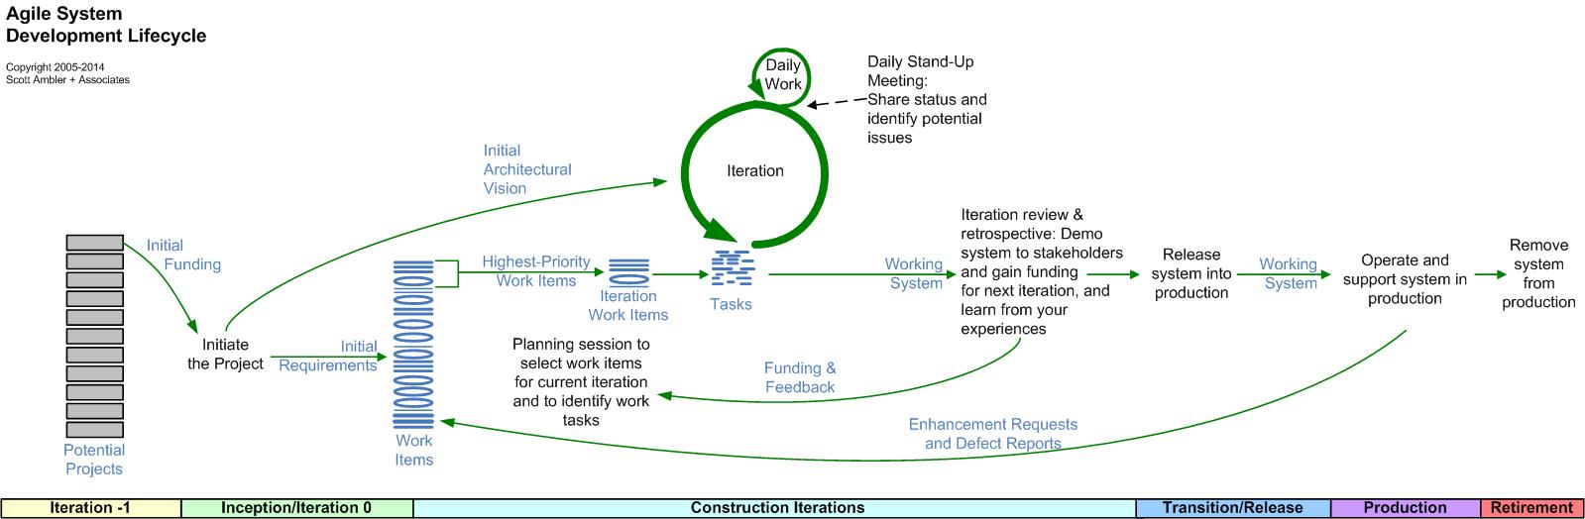
Methodology – Agile Analysis
User Stories
Backlogs
Sprints
Agile Roles
Agile Approaches - Scrum
Sprint Meetings
Figure 2: The Agile System Development Life Cycle (Ambysoft, 2012)

Slide 13
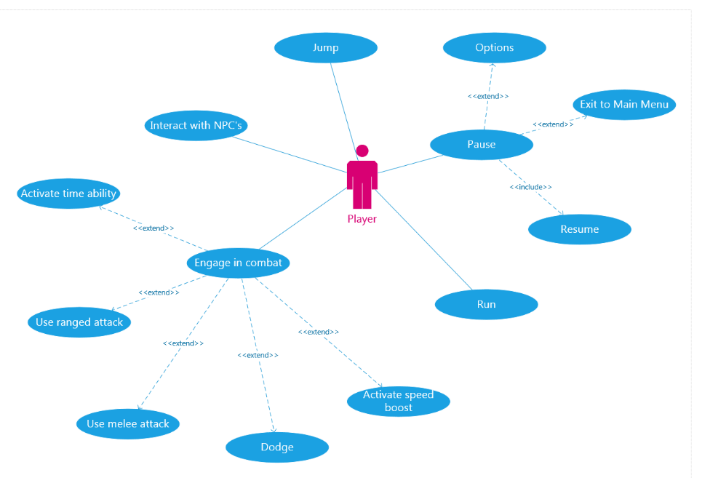
Methodology - UML
Use Case
External user interaction
Actions
Communication
Sequenced messages
Used for Main Menu

Slide 14
Requirements
Literature survey research – Time abilities
User Stories
As a <role> I want <feature> because <reason>
Example:
As a Player I want Chronos to dodge so that I can avoid enemy attacks
Requirement:
Create a dodge ability for Chronos

Slide 15
Design - Research
Agile structures design iteratively
Backlog
Sprint Plan
UML
Requirements gathering informs design objectives
Anticipate Risk – Extra requirements

Slide 16
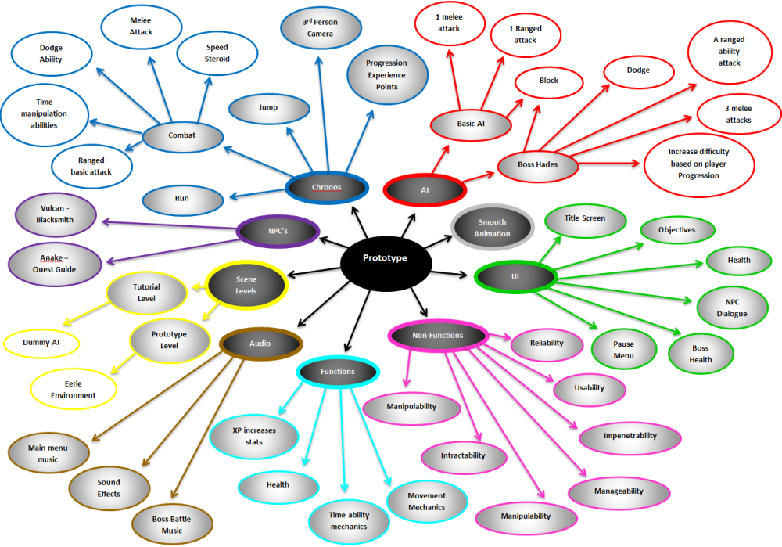
Brainstorm

Slide 17
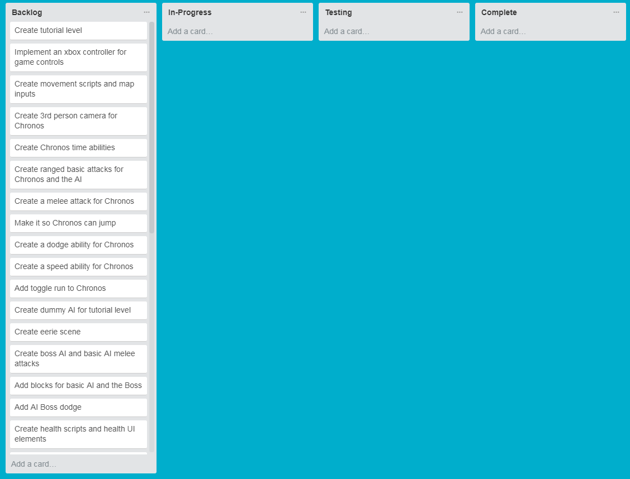
Design - Backlog
Scrum approach (Lacey, 2016, pp. 6-7)
Prioritised list
Trello (Trello, 2010)

Slide 18
Design – Sprint Plan
Structures development and testing process
Sprint meetings
Underpinned by brainstorm and backlog
Sprint 1:
Starts 20/12/17 – Ends 10/01/18
Create tutorial level
Implement an Xbox controller for game controls
Create movement scripts and map inputs
Create 3rd person camera for Chronos
Create Chronos time abilities
Create ranged basic attacks for Chronos
Create a melee attack for Chronos

Slide 19
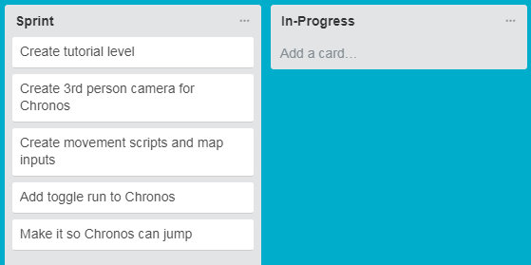
Sprint 1
Development:
Scene based on Greek mythology and Smite (Curse Inc, 2017)
Mouse look script (Unity Technologies, 2012)
Scratch player controller
Testing:
X-axis camera
Toggle run
Unrealistic jump (Board To Bits Games, 2017)

Slide 20
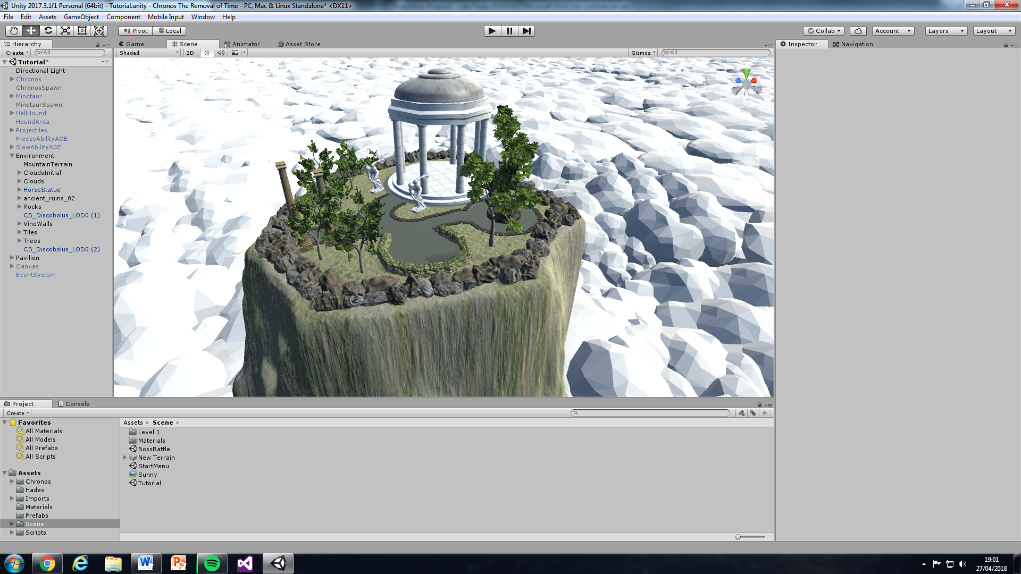
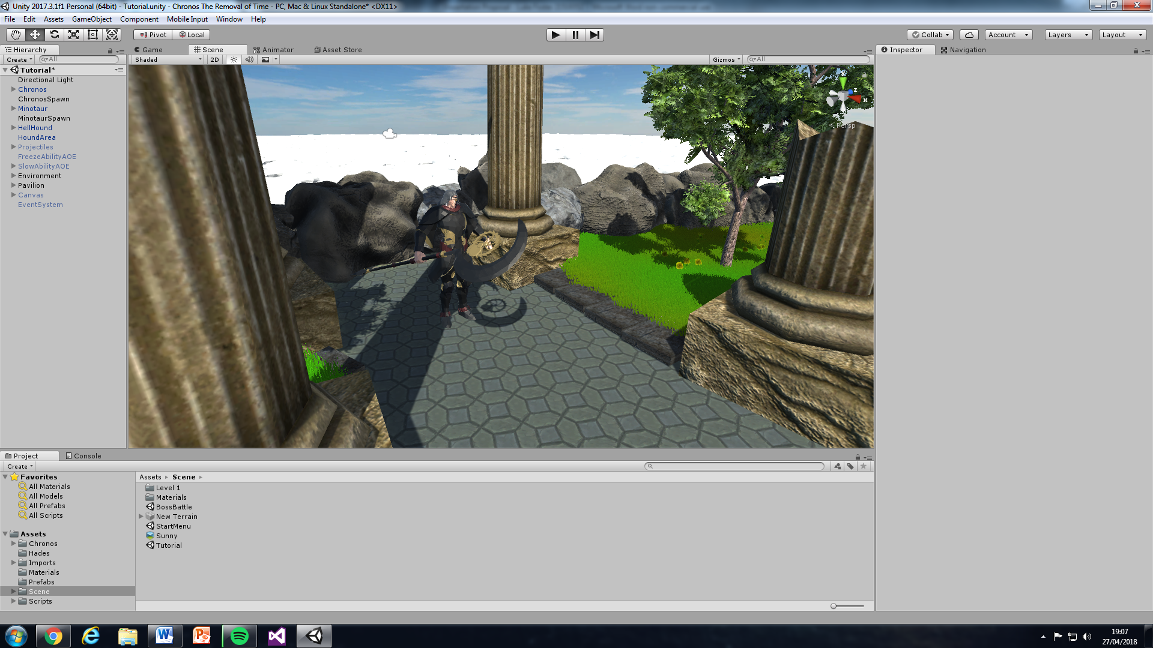
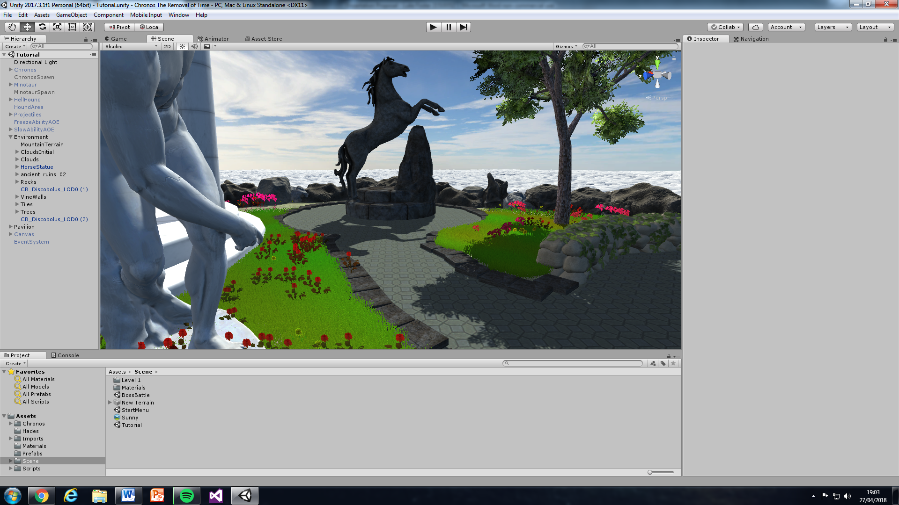

Slide 21
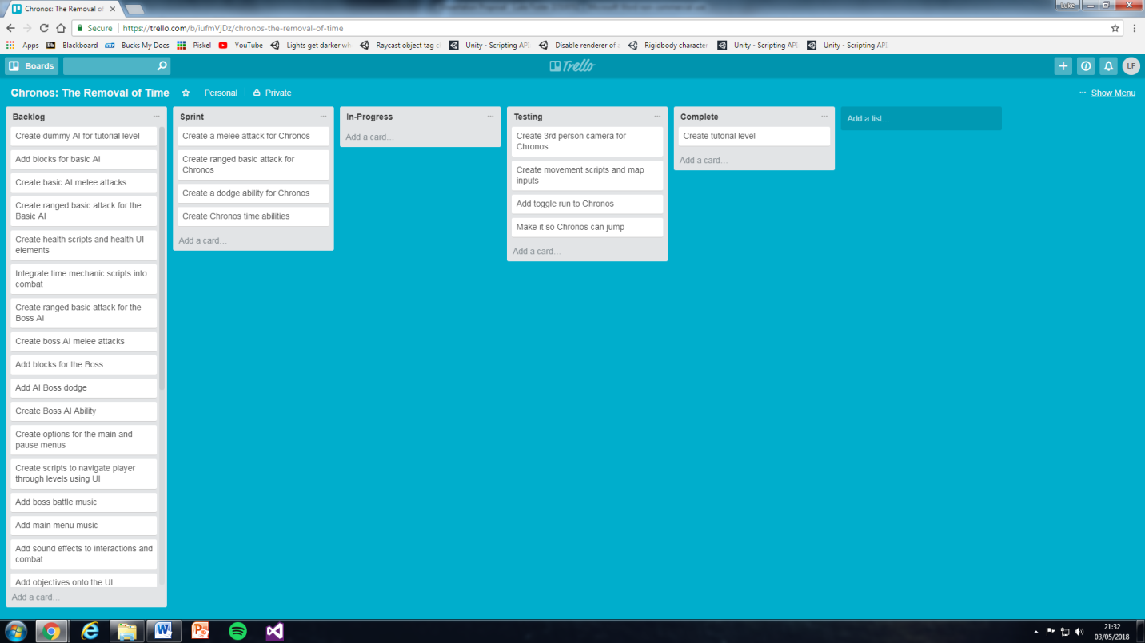
Sprint 2
Development:
Toggle attack implemented
Speed and Rewind abilities (Brackeys, 2017)
Dodge evolution reduced to four directions
Testing:
Step Check (TwiiK, 2007)

Slide 22
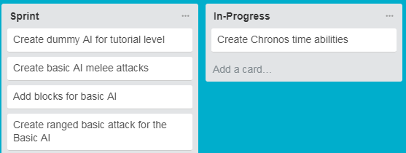
Sprint 3
Development:
Finite state machine
Ability casting only
Testing:
Dummy AI needs UI to continue
Abilities cast out of camera view
Distance (Unity Technologies, 2017)
Dot product (Unity Technologies, 2017)

Slide 23
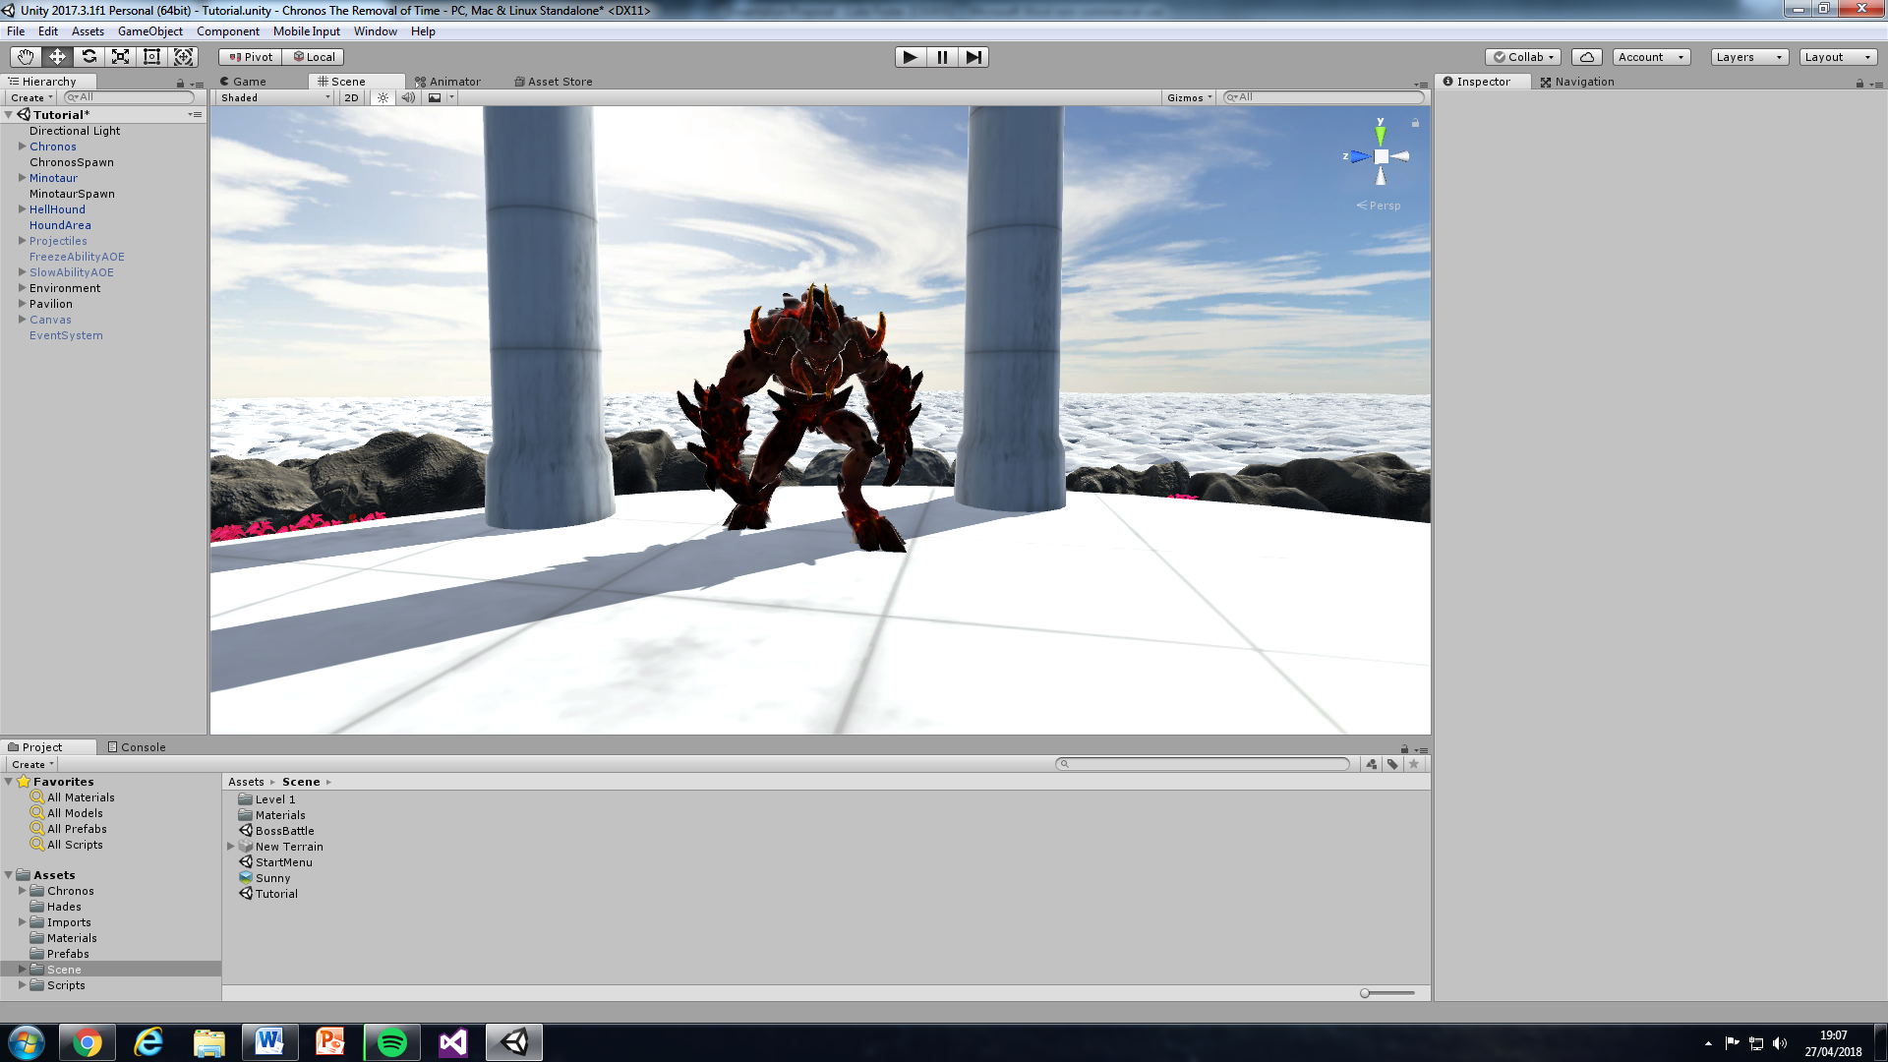
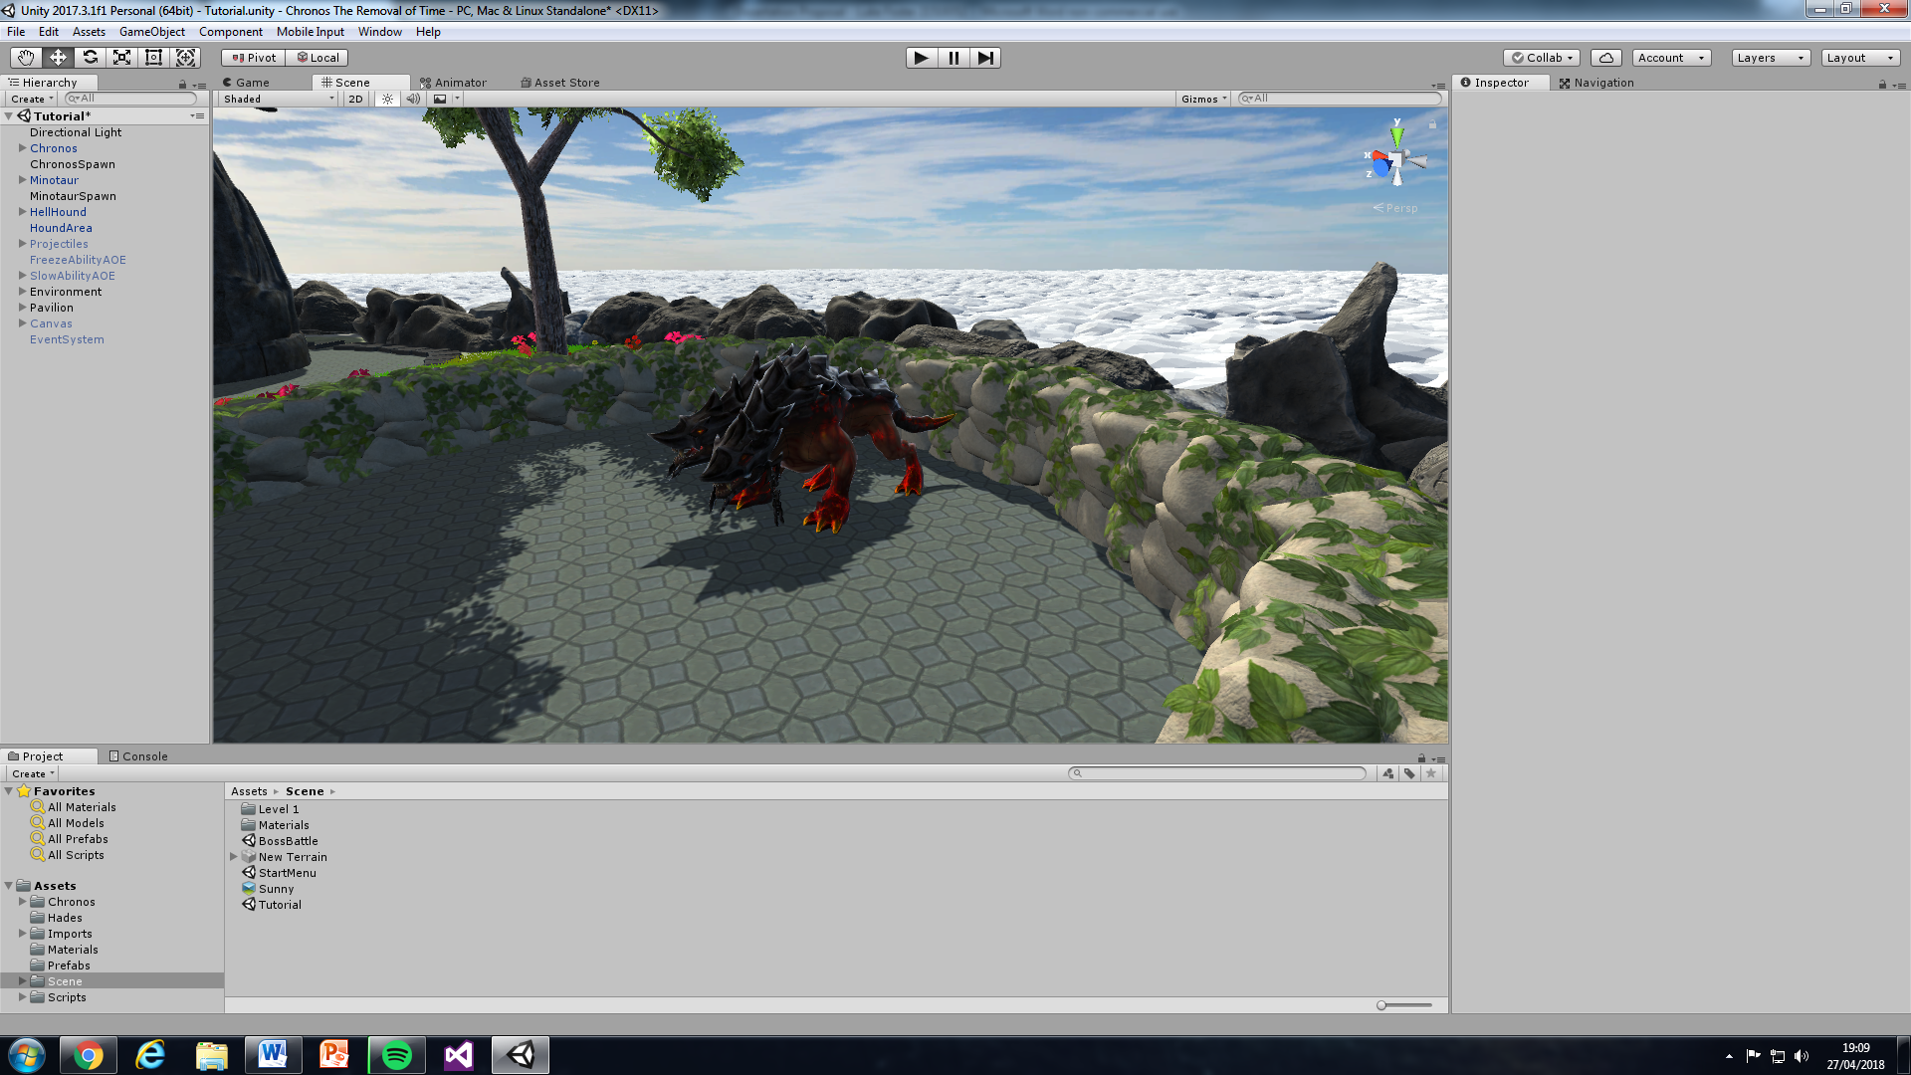
Sprint 3
Figure 3 & 4: Hell Hound 3D Model & Hell Minotaur 3D Model (Cadnav, 2018)

Slide 24
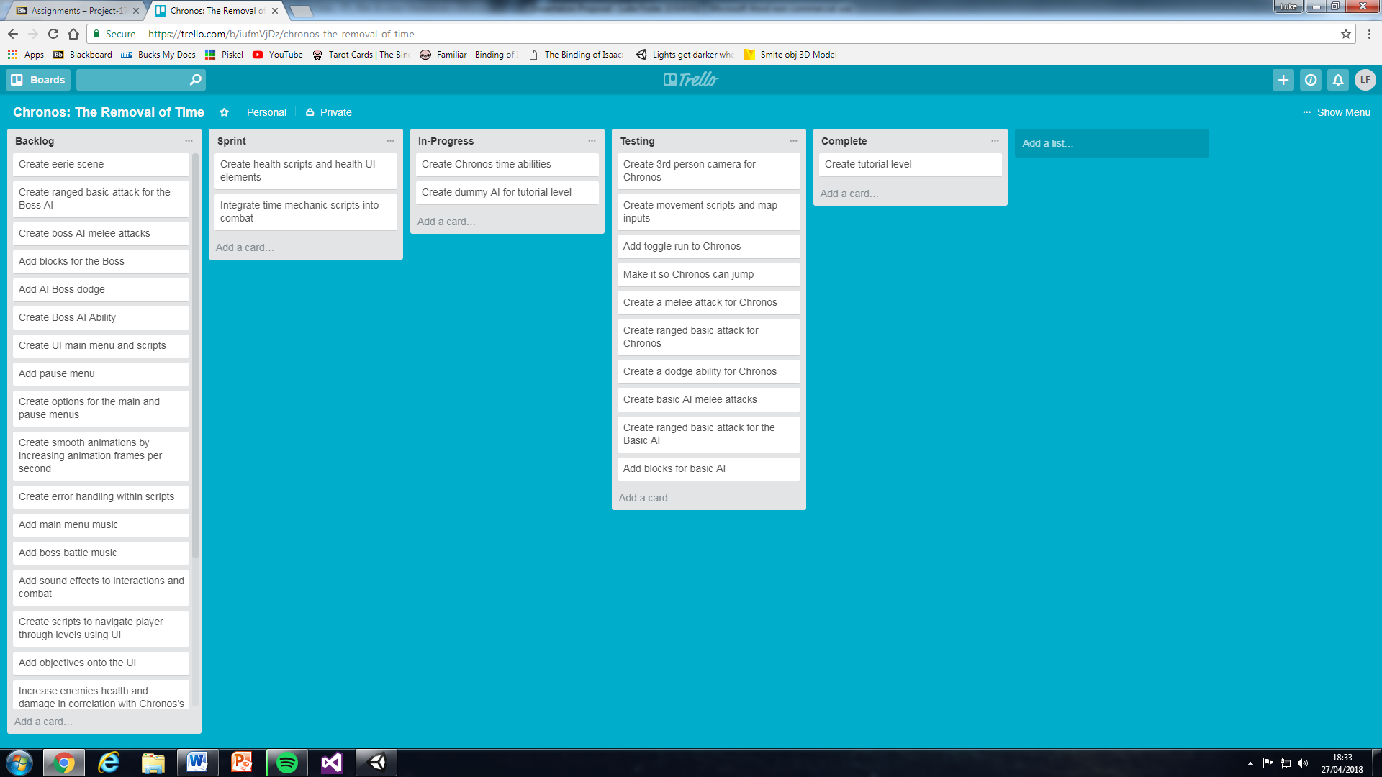
Sprint 4
Development:
Ability damage effects and UI
Risk met – Scope increased
Testing:
Slow and Freeze still visible after detonation (chaosmaker, 2013)

Slide 25
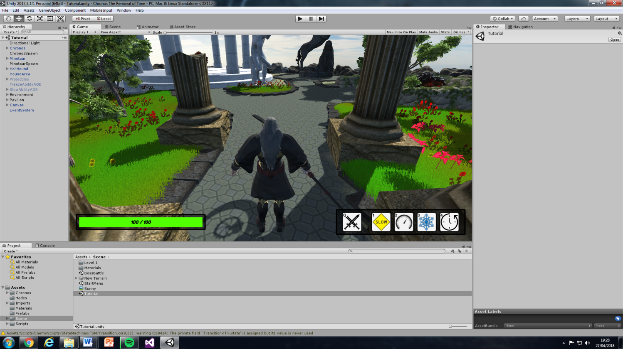
Sprint 4
Figure 5: UI Health Bar (Tank & Healer Studio, 2018)

Slide 26
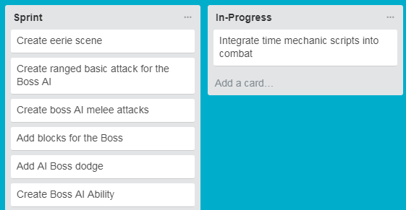
Sprint 5
Development:
Scene inspired by Hell models (CadNav, 2018)
Reusable code from Chronos
Testing:
Risk met – Merging content across scenes
Hades ground check (Getyour411, 2013)

Slide 27
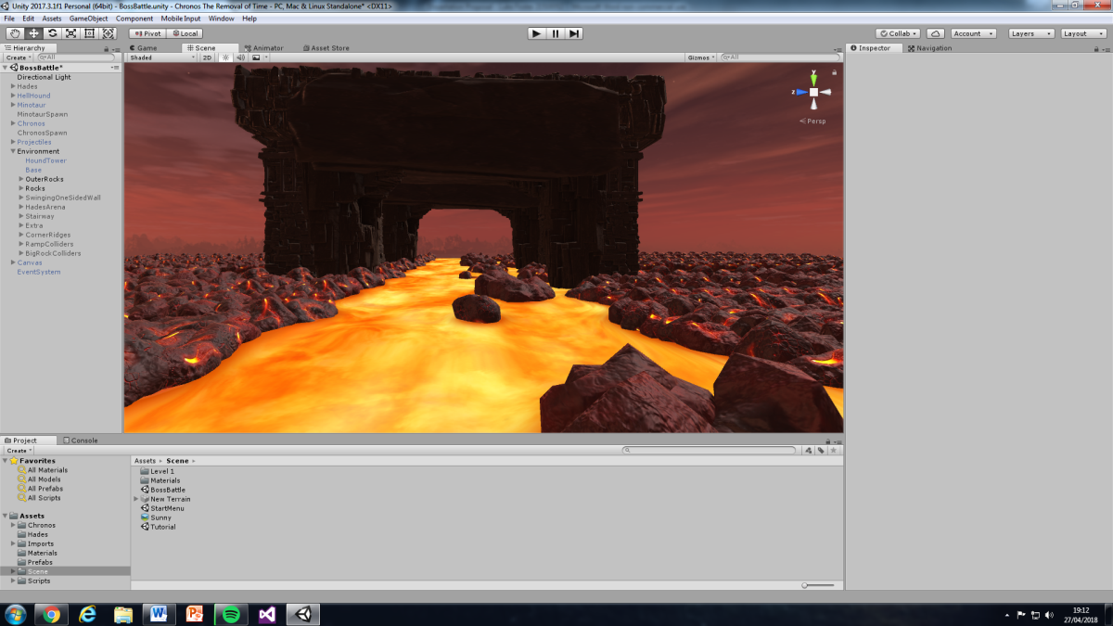
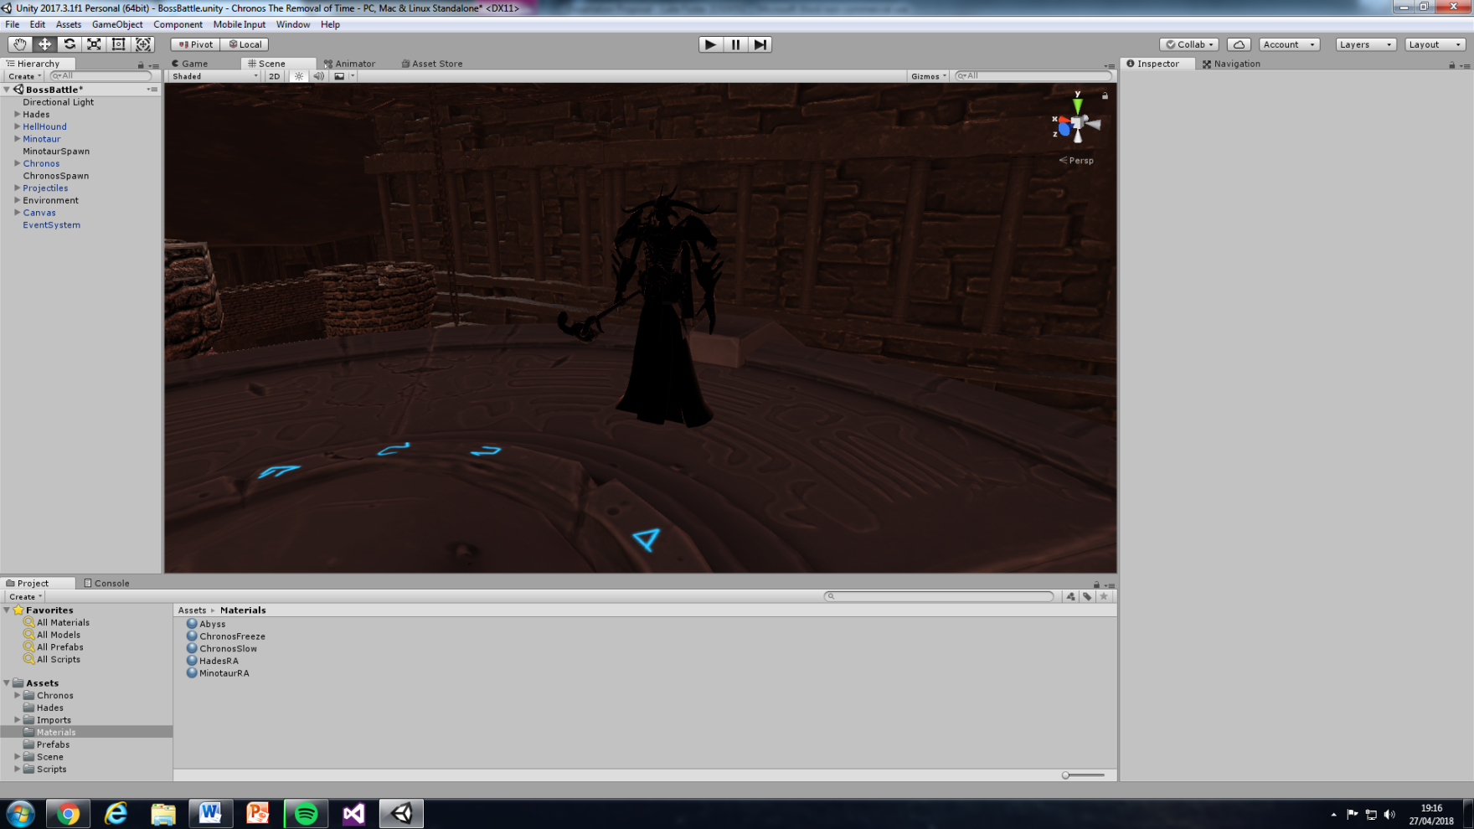
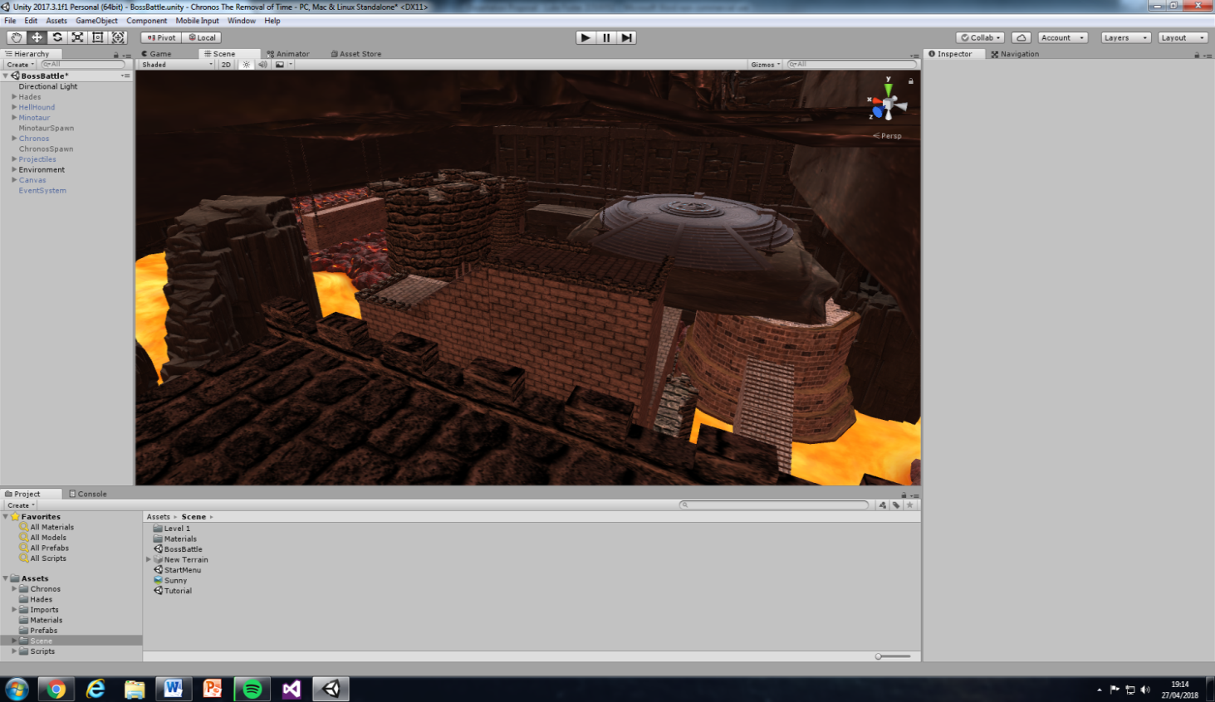
Figure 6: Assets (Moonflower Carnivore, 2015; Ebal Studios, 2017; Koppel, 2017)
Figure 8: Hades (Spectro57, 2015)
Figure 7: Assets (Aquarius Max, 2014; Vladut, 2017)

Slide 28
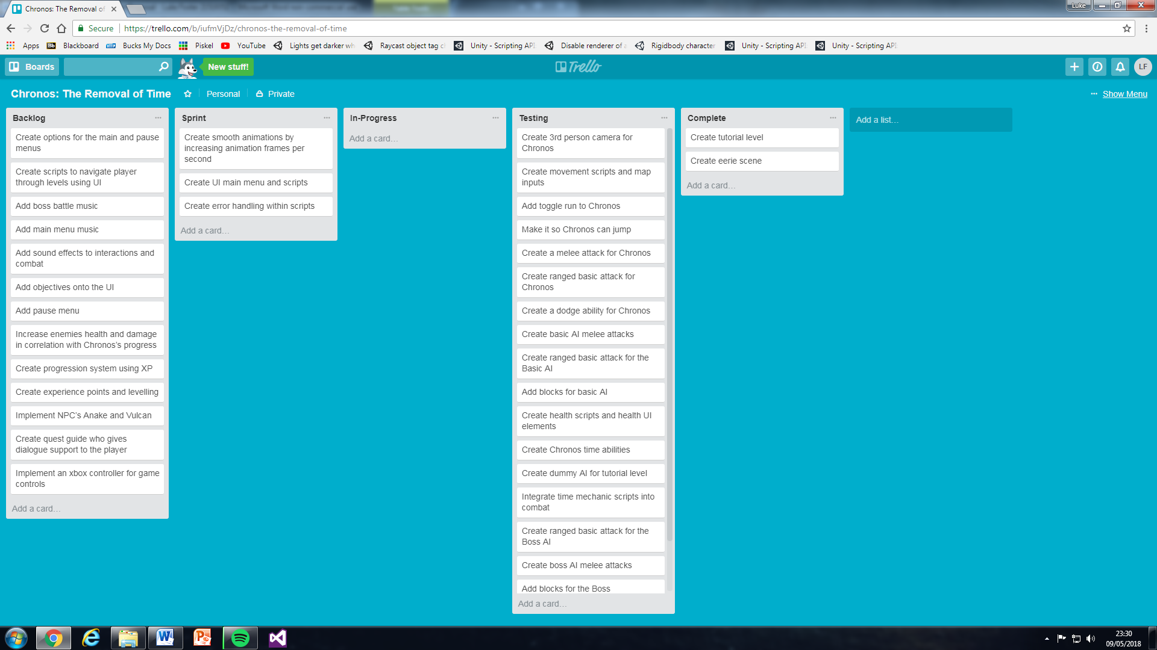
Sprint 6
Development:
Mixamo (Adobe Systems Incorporated, 2018)
Re-model
Error handling has been a constant
Testing:
Boss Battle return to area
Boss Battle animations

Slide 29
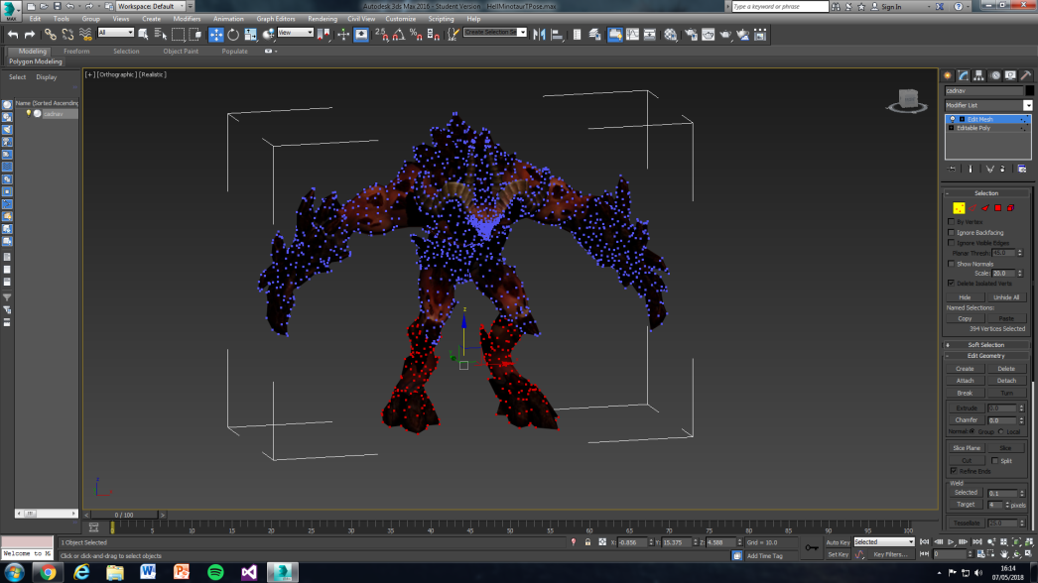
Sprint 6
Figure 9: Autodesk 3DS Max (Autodesk, 2018)

Slide 30
Development Summary
Behind on schedule compared to sprint plan
Less time developing scenes
Objectives complete, apart from pseudo code
Risk - AI state machine and states should’ve been their own requirements
Scene content clash, should requirement gather at start of sprints
Remaining requirements

Slide 31
Implementation – Working Environment
Further development – Xbox market (Filmstorm, 2017)
UK copyright law or Patent design (gov, 2017)
Research market (Monosoff, 2006)
Presentation (Monosoff, 2006)
Smite campaign (IGN, 2014)

Slide 32
Implementation – Current Version Issues
Walk speed jump
Jolting through objects – physics step
Dual casting / instant casting
Minotaur stuck in walk animation when rewinding

Slide 33
Conclusion
Objectives completed apart from pseudo
Aim met
Remaining requirements
Summarise

Slide 34
Recommendations for Further Work
Fixing current version issues
Recreating a physics based movement and jump system (Unity, 2014)
Dual Casting
Animations

Slide 35
References
Figure 1: Presentation Process, 2013. PowerPoint Waterfall Model [Online]
Available at: https://www.youtube.com/watch?v=_ZKvvaZEFKE
[Accessed 17 05 2018]
Figure 2: Ambysoft, 2012. The Agile System Development Life Cycle (SDLC) [Online]
Available at: http://www.ambysoft.com/essays/agileLifecycle.html
[Accessed 20 12 2017]
Figure 3: CadNav, 2018. Lava Hellhound 3D Model. [Online] Available at: http://www.cadnav.com/3d-models/model-38871.html [Accessed 30 01 2018].
Figure 4: CadNav, 2018. Lava Minotaur Demon 3D Model. [Online] Available at: http://www.cadnav.com/3d-models/model-38868.html [Accessed 30 01 2018].
Figure 5: Tank & Healer Studio, 2018. Simple Health Bar. [Online] Available at: https://assetstore.unity.com/packages/tools/gui/simple-health-bar-free-95420 [Accessed 01 03 2018].
Figure 6: Moonflower Carnivore, 2015. Lava Flowing Shader. [Online] Available at: https://assetstore.unity.com/packages/vfx/shaders/lava-flowing-shader-33635 [Accessed 14 03 2018].

Slide 36
References
Figure 6: Ebal Studios, 2017. Space Shooter Asteroids. [Online] Available at: https://assetstore.unity.com/packages/vfx/shaders/lava-flowing-shader-33635 [Accessed 20 03 2018].
Figure 6: Koppel, S., 2017. Boss of War | Assets. [Online] Available at: https://assetstore.unity.com/packages/3d/environments/boss-of-war-assets-86108 [Accessed 02 04 2018].
Figure 7: Aquarius Max, 2014. Castle Supply Lite. [Online] Available at: https://assetstore.unity.com/packages/3d/environments/fantasy/castle-supply-lite-23699 [Accessed 20 03 2018].
Figure 7: Vladut, O., 2017. Skull Platform. [Online] Available at: https://assetstore.unity.com/packages/3d/props/skull-platform-105664 [Accessed 01 04 2018].
Figure 8: Spectro57, 2015. Gods of smite. [Online] Available at: https://www.thingiverse.com/thing:926531 [Accessed 01 02 2018].
Figure 9: Autodesk, 2018. 3DS Max. [Online] Available at: https://www.autodesk.co.uk/products/3ds-max/overview?mktvar002=716535&mkwid=sBUZXOmjF|pcrid|212217280485|pkw|3ds%20max|pmt|e|pdv|c|slid||pgrid|46458173452|ptaid|kwd-13133432|&intent=&utm_medium=cpc&utm_source=google&utm_campaign=GGL_3dsMax_UK_BR_SEM&utm_t [Accessed 05 05 2018].

Slide 37
References
Adobe Systems Incorporated, 2018. Mixamo. [Online] Available at: https://www.mixamo.com/#/ [Accessed 07 05 2018].
Board To Bits Games, 2017. Better Jumping in Unity With Four Lines of Code. [Online] Available at: https://www.youtube.com/watch?v=7KiK0Aqtmzc [Accessed 18 01 2018].
Brackeys, 2017. How to make Slow Motion in Unity - Bullet Time Tutorial. [Online] Available at: https://www.youtube.com/watch?v=0VGosgaoTsw [Accessed 10 07 2017].
Brackeys, 2017. Rewind Time in Unity. [Online] Available at: https://www.youtube.com/watch?v=eqlHpPzS22U [Accessed 10 07 2017].
chaosmaker, 2013. Disable renderer of a child. [Online]
Available at: https://answers.unity.com/questions/571068/disable-renderer-of-a-child.html
[Accessed 19 03 2018].
Cogswell, J., 2010. REVIEW: MonoDevelop 2.2 Looks Good on Windows. [Online] Available at: http://www.eweek.com/development/review-monodevelop-2.2-looks-good-on-windows [Accessed 25 10 2017].

Slide 38
References
Curse Inc, 2017. Training. [Online] Available at: https://smite.gamepedia.com/Training [Accessed 21 12 2017].
Evans-Thirlwell, E., 2017. How video games win back time. [Online] Available at: http://www.eurogamer.net/articles/2017-08-26-on-games-as-time-travel-machines [Accessed 24 10 2017].
Filmstorm, 2017. How to Build a Unity Game to Xbox One. [Online] Available at: https://www.youtube.com/watch?v=uibEl3SmI1k [Accessed 05 05 2018].
Gamepedia, 2018. Chronos [Online]
Available at: https://smite.gamepedia.com/Chronos
[Accessed 17 05 2018]
Getyour411, 2013. Simple raycast telling distance from ground. [Online] Available at: https://answers.unity.com/questions/531544/simple-raycast-telling-distance-from-ground.html [Accessed 10 04 2018].
gov, 2017. How copyright protects your work. [Online] Available at: https://www.gov.uk/copyright [Accessed 05 05 2018].

Slide 39
References
IGN, 2014. Smite Starter Guide. [Online] Available at: http://uk.ign.com/wikis/smite/Starter_Guide [Accessed 06 05 2018].
Jackson, L. B., 2014. Smite Review. [Online] Available at: http://uk.ign.com/articles/2014/04/01/smite-review [Accessed 16 07 2017].
Lacey, M., 2016. The Scrum Field Guide. Second Edition ed. London: Pearson.
Monosoff, T., 2006. Three Steps to Selling Your Idea. [Online] Available at: https://www.entrepreneur.com/article/83496 [Accessed 06 05 2018].
NeuralFrights, 2017. Dark Souls Combat System 101: The complex mechanics explained. [Online] Available at: http://fighter101.net/main/2017/03/19/dark-souls-combat-system-101-the-complex-mechanics-explained/ [Accessed 08 10 2017].
Sullivan, L., 2014. Top 7... Greatest uses of time control in gaming. [Online] Available at: http://www.gamesradar.com/top-7-greatest-uses-time-control-game-mechanic/ [Accessed 24 10 2017].
Trello, 2010. About Trello [Online]
Available at: https://trello.com/about
[Accessed 15 12 2017]

Slide 40
References
TwiiK, 2007. Rigidbody character controller with step handling. [Online]
Available at: https://forum.unity.com/threads/rigidbody-character-controller-with-step-stairs-handling-like-the-default-character-controller.318239/ [Accessed 28 01 2018].
Unity, 2014. High-performance physics in Unity 5. [Online] Available at: https://blogs.unity3d.com/2014/07/08/high-performance-physics-in-unity-5/ [Accessed 06 05 2018].
Unity, 2017. Time. [Online] Available at: https://docs.unity3d.com/ScriptReference/Time.html [Accessed 24 10 2017].
Unity, 2018. The world’s leading content-creation engine. [Online]
https://unity3d.com/unity
[Accessed 18 05 2018]
Unity Technologies, 2012. Mouse Look Script Help. [Online] Available at: https://answers.unity.com/questions/302795/mouse-look-script-help-1.html [Accessed 08 01 2018].

Slide 41
References
Unity Technologies, 2017. Vector3.Distance. [Online] Available at: https://docs.unity3d.com/ScriptReference/Vector3.Distance.html [Accessed 20 01 2018].
Unity Technologies, 2017. Vector3.Dot. [Online] Available at: https://docs.unity3d.com/ScriptReference/Vector3.Dot.html [Accessed 20 01 2018].
Zarzecki, M., 2016. How to Build a Prince-of-Persia-Style Time-Rewind System, Part 1. [Online] Available at: https://gamedevelopment.tutsplus.com/tutorials/how-to-build-a-prince-of-persia-style-time-rewind-system-part-1--cms-26090 [Accessed 24 10 2017].

